Slide 1
Aeroplane Crash Presentation
Presented By-
Vismitha PY - 20181IST0090
Amulya S - 20181IST0008
Samarth KP - 20181IST0069
Sindhu Shree R - 20181IST0071
Vinaya S - 20181IST0089

Slide 2
What is Data Visualization?
Data visualization is the graphical representation of information and data.
It is the process of translating large data sets and metrics into charts, graphs and other visuals.
By using visual elements like charts, graphs, and maps, data visualization tools provide an accessible way to see and understand trends, outliers, and patterns in data.
The resulting visual representation of data makes it easier to identify and share real-time trends, outliers, and new insights about the information represented in the data.

Slide 3
Why Data Visualization?
Our eyes are drawn to colors and patterns.
We can quickly identify red from blue, square from circle.
Our culture is visual, including everything from art and advertisements to TV and movies.
Data visualization is another form of visual art that grabs our interest and keeps our eyes on the message.
When we see a chart, we quickly see trends and outliers.
If we can see something, we internalize it quickly.
It’s storytelling with a purpose.

Slide 4
Our Project
Air travel has been one of the major modes of travel along with land, water and rail.
It’s a possibility that there is chances of accident to occur during the flight time.
Flight crashes are something that is common since its invention.
Flight crashes may be caused due to pilot error, mechanical failure, bad weather, sabotages or human error.
In our project, we have visualised the various perspectives of the crash and analysed the details of the crash.

Slide 5
Dataset
Date: It is the date when the accident took place.
Time: It is the time when the accident took place.
Location: It the place where the accident has been reported to occur.
Operator: It says if the flight was a government owned or private.
Aboard: It tells the number of passengers that were on board during the flight accident.
Fatalities: It the number of deaths that occurred in the accident.

Slide 6
Flight #: It the serial number assigned to flights.
Route: It is the route which the flight takes.
Type: It describes about the type of flight.
Registration: It tells about the registration number of the flight.
cn/In: It is the units of measurement of flight dimensions.
Ground: It tells number of people that passed away on ground those who weren’t on board.
Summary: It describes about the way the accident occurred.

Slide 7
Libraries
Numpy: It is a Python library used for working with arrays.
Pandas: Pandas is a Python library used for working with data sets.
Matplotlib: Matplotlib is a low level graph plotting library in python that serves as a visualization utility.
Seaborn: Seaborn is a library mostly used for statistical plotting in Python. It is built on top of Matplotlib and provides beautiful default styles and colour palettes to make statistical plots more attractive.
Datetime: In Python, date and time are not a data type of their own, but a module named datetime can be imported to work with the date as well as time.

Slide 8
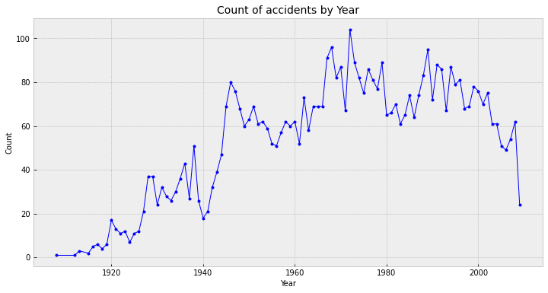
Count the number of accidents occurred YEARLY

Slide 9
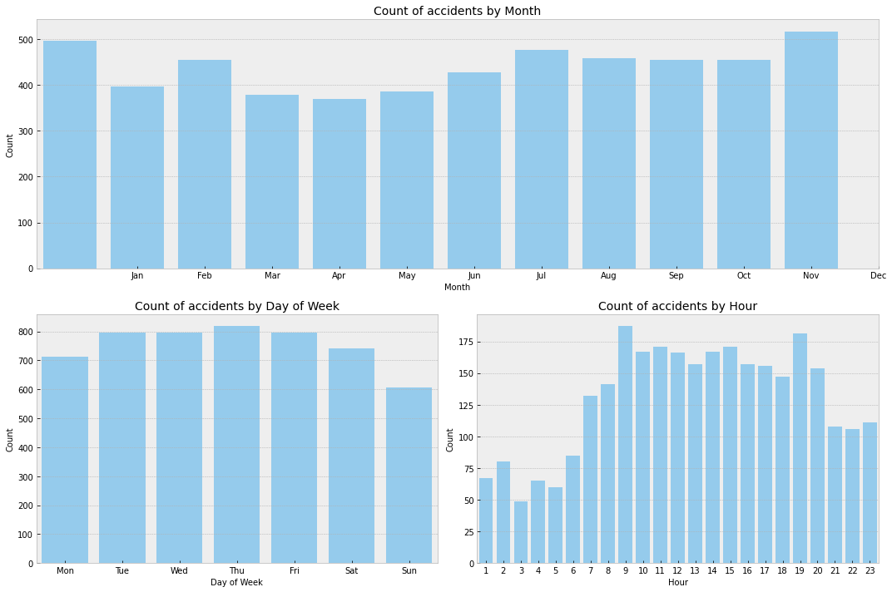
Count the number of accidents occurred MONTHLY

Slide 10
Count the number of accidents occurred by DAYS OF THE WEEK & HOURS OF THE DAY

Slide 11
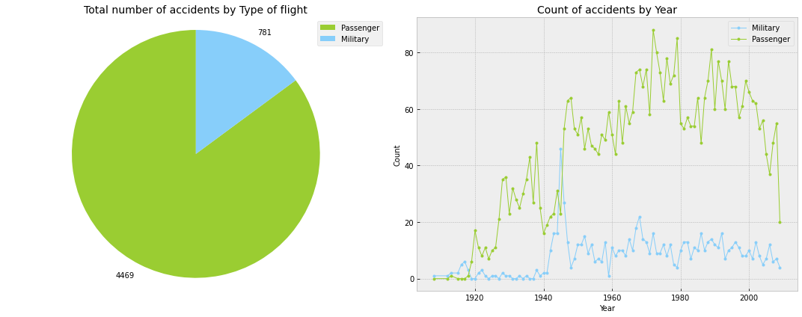
Count of accidents by TYPE OF FLIGHT and BY YEAR

Slide 12
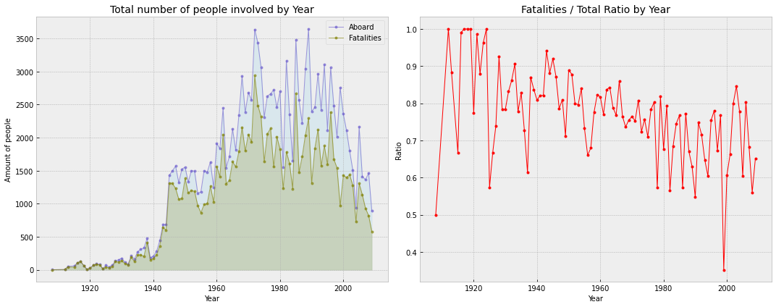
Count of TOTAL NUMBER PEOPLE INVOLVED & FATALITY RATIO

Slide 13
THANK YOU

